Slide 1
Technical content
Xyleme Tetiana Tsakun Technical writer

Slide 2


Agenda
Technical writing
Technical interviews

Slide 3
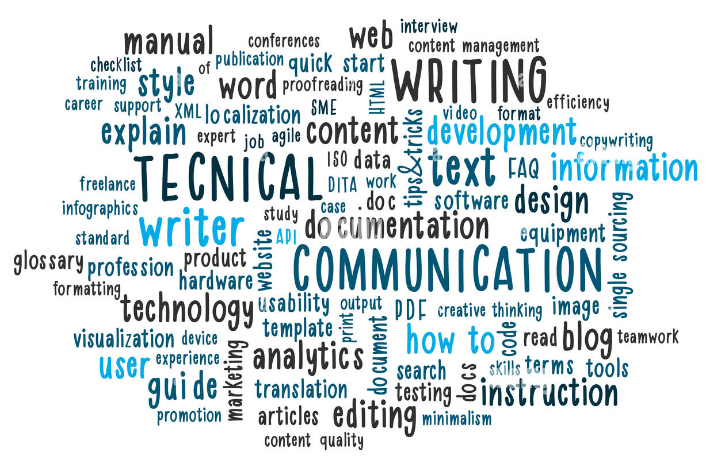
1. Technical writing
A technical writer is a professional writer that gathers, processes, and communicates complex information in clear, concise, and easy-to-understand piece.

Slide 4

Skill set
Technical writing is a type of writing that involves a specific set of skills:
Knowledge of technologies.
Critical thinking.
Writing ability.
Organizational skills.
Detective skills.
Listening skills.
People and communication skills.
Editing skills.
Designing skills.
Writing
Teamwork
Editing
Design

Slide 5
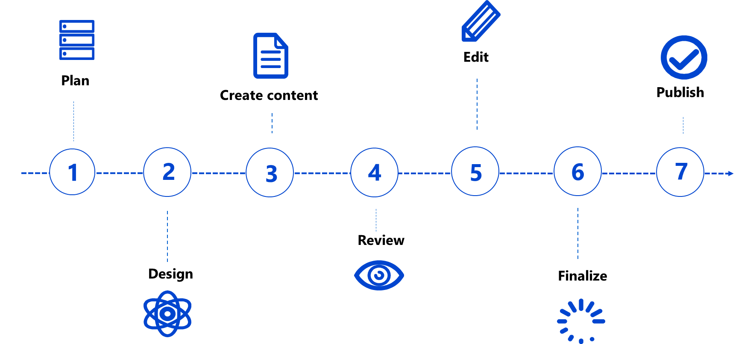
DDLC
Documentation development life cycle (DDLC) is the practice of developing a document that involves a systematic process that continues in cyclic order.

Slide 6
Deliverables
Documentation solutions
User guides
Knowledge bases
Configuration guides
API documentation
UI text
Presentations, demos, etc.

Slide 7


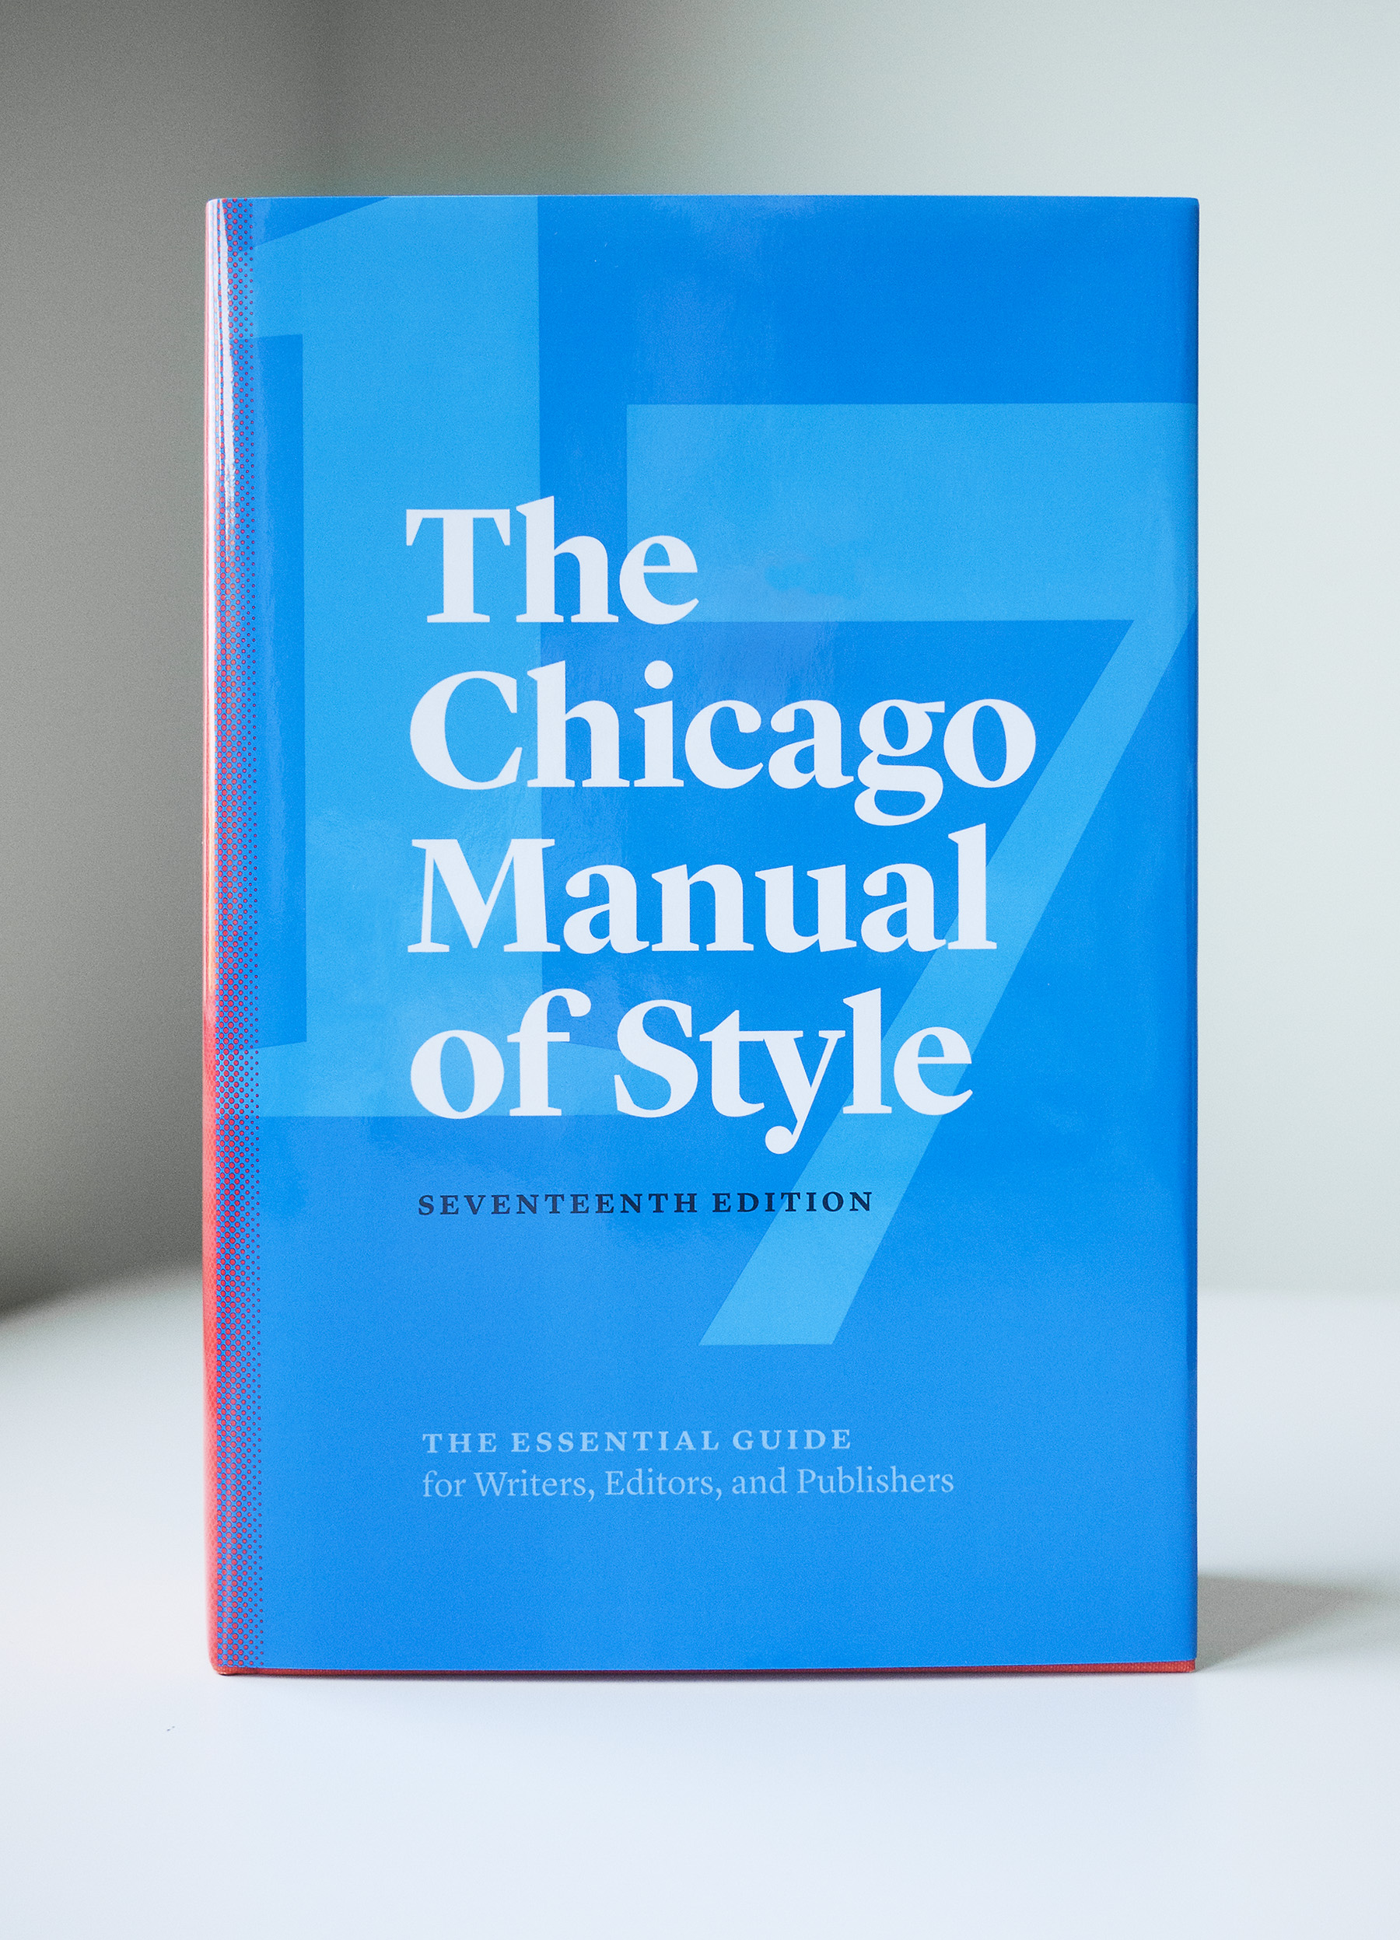




Standards and guidelines
Google developer documentation style guide
The Chicago Manual of Style
Apple Style Guide
Microsoft Style Guide

Slide 8
Technical writing tools
Publishing tools (Adobe FrameMaker, RoboHelp, Xyleme)
Diagrams, charts (PlantUML, draw.io)
Authoring tools (MS Word, Markdown Editor, Confluence)
Screen Capture tools (Snipping Tool, TechSmith Snaggit)
Image Editing tools (Abobe Photoshop, TechSmith Snagit)
Spell check tools (Grammarly, etc.)

Slide 9
Technical writing: content types
Conceptual It helps readers map their knowledge and understanding to the tasks they need to perform and to provide other essential information about a product, process, or system. For example, an overview of the bicycle, its usage, types, etc.
Procedure It provides step-by-step instructions. It helps a reader to complete a specific task. For example, instructions on how to replace a bicycle rear wheel.
Reference It provides information that you may need to look up, some additional information. For example, it may contain cycling or bicycle related terms.

Slide 10
2. Technical interviews
General steps
1. Prepare
2. Interview
3. Create content
4. Ask for review and publish

Slide 11

2. Technical interviews. Prepare
Establish a purpose and a scope of the interview. Note: Just as important as knowing your audience is knowing why you are writing what you are writing.
Identify what you already know in advance, get ready, make a research on the subject. Note: Find out about the topic, research information that can be useful. As a technical writer, you are serving as a proxy for the final reader of your document. Think what your readers will use the content for and what information will serve their goals.
Plan your interview. Prepare a list of questions in advance. Note: When you set up the interview, relay the information you are most interested in and share the purpose of the piece you are creating. This will give your SME a context for the meeting.

Slide 12


2. Technical interviews Interview
Listen carefully and take notes on thoughts that you may have. Note: Active listening shows your interest, attentiveness, and conveys your care about what the speaker says. It also helps you notice details that you need to clarify. Ask your SME if you can record the interview so you can refer back to it for accuracy. It will help to be an active participant in the interview, rather than to be preoccupied with taking notes all the time.
Clarify or ask for details if needed. Don’t be afraid of asking questions. Note: There are no bad questions. The answers you get will help your readers understand a topic or perform an action and get the expected result. They will prevent a future user of your content from getting confused or frustrated.
If possible, ask your SME to share links and screenshots that can be useful for the content you need to create. Note: You may not always be able to find the information you need by yourself or have access to make screenshots. If you know that the visual content you see will be useful for your readers, ask your SME to share it.

Slide 13

2. Technical interviews Create, review, and publish
Follow-up as needed. Note: Ask SME if it is okay to contact them later if you need more information or want to clarify something you have already discussed. If you are concerned that they might not be responsive, set up a time for a brief second interview before you wrap up the first.
Analyze, create, and then ask SME for a review. Note: As you write, carefully fact-check information if you have the slightest doubts. Write down any gaps in the information and enlist additional questions you have for SME. Review what you have written to avoid mistakes or inconsistency. Ask you SME for the review. Once you receive feedback – edit your content, make sure it is ready for the readers, and publish it.

Slide 14

Thanks

